Slide 1
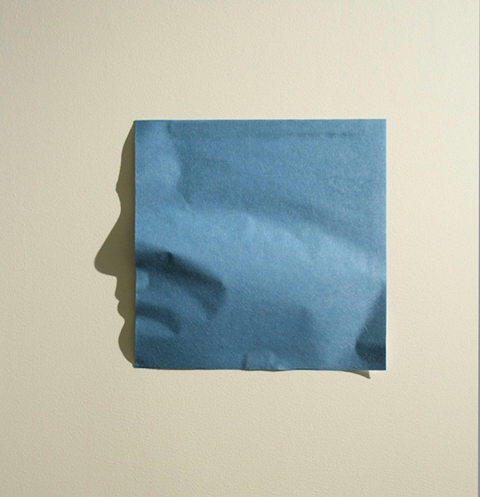
Notes Towards
Documentary Poetics:
A Post-Cartesian Reflection
Kyoo Lee

Slide 2


Slide 3


Slide 4


Slide 5
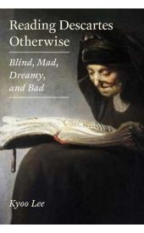
I. Turn
II. Turn To
III. Return To

Slide 6
I/III Turn:
“Know Thyself” to
“Know Thyselfie”
U-I-i…x

Slide 7
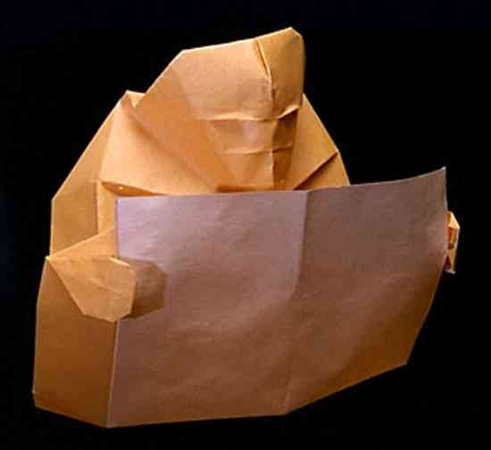

Slide 8
II/III Turn To:
iThink 3.0, something in the middle of

Slide 9
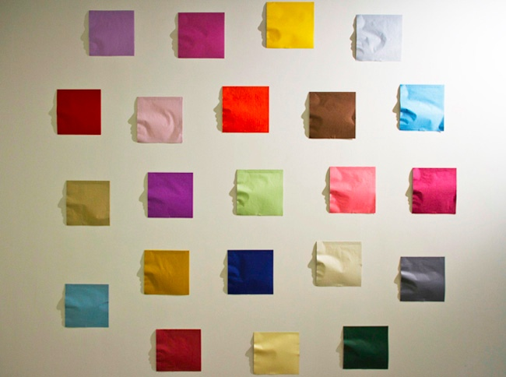

Slide 10
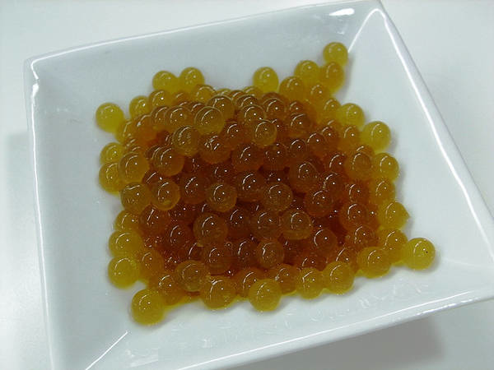

Slide 11
III/III RETURN To/Of:
Cogitø

Slide 12
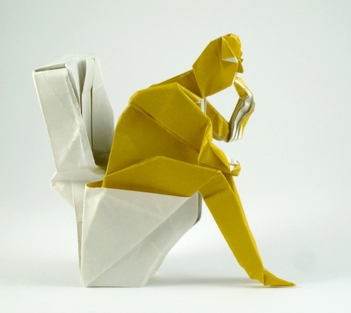

Slide 13
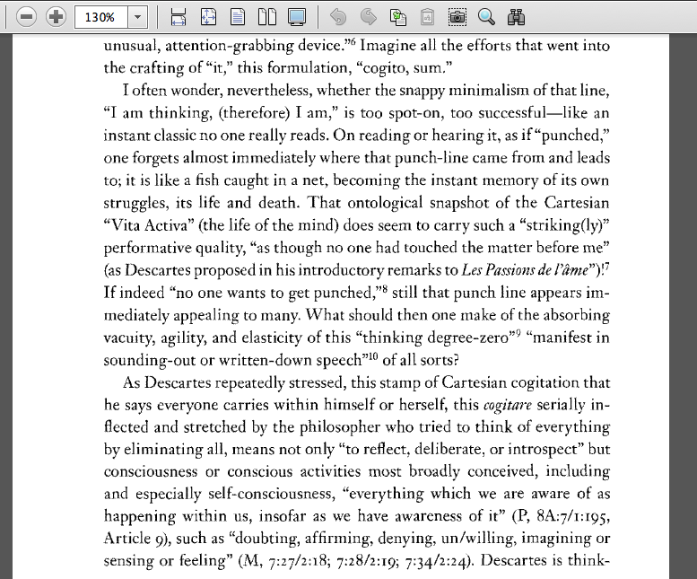

Slide 14
Cogitø
(생각,生覺, Saenggak,
Vita Activa),
Time of/for

Slide 15


