Slide 1
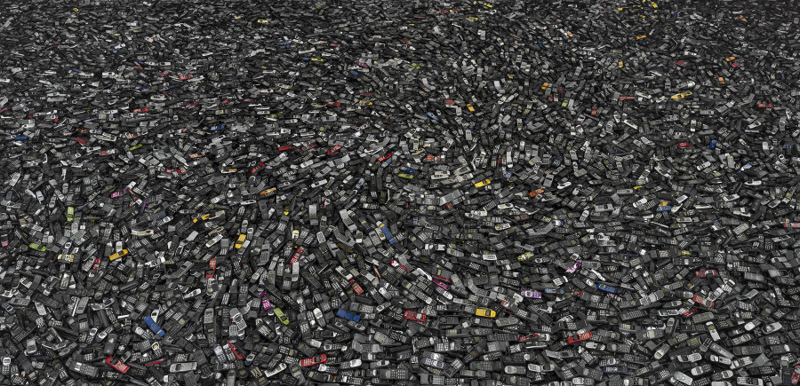
All that culture: Of civilizational garbage/shortage and Process-relational Thinking
Kyoo lee
(The City University
of New York)
with Song Tian
Notes:
Chris Jordan, Cell Phones #2, Atlanta 2005, Intolerable Beauty: Portraits of American Mass Consumption

Slide 2
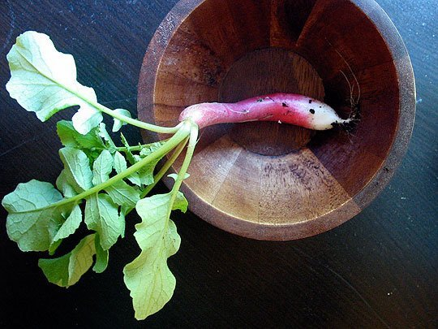
Notes:
Radish Greens| 시래기 된장국

Slide 3
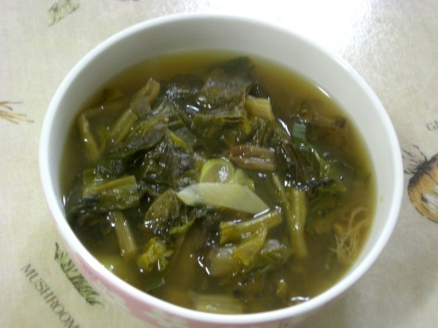
Notes:
Radish Greens| 시래기 된장국

Slide 4
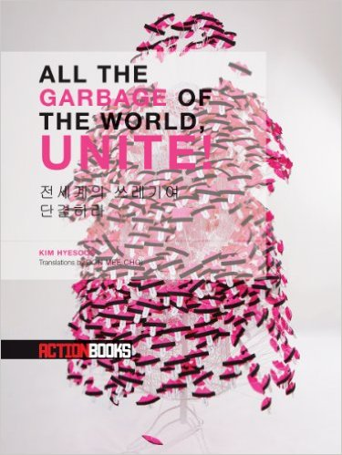

Slide 5
A Trash Talk
One is not born trash but becomes one.

Slide 6
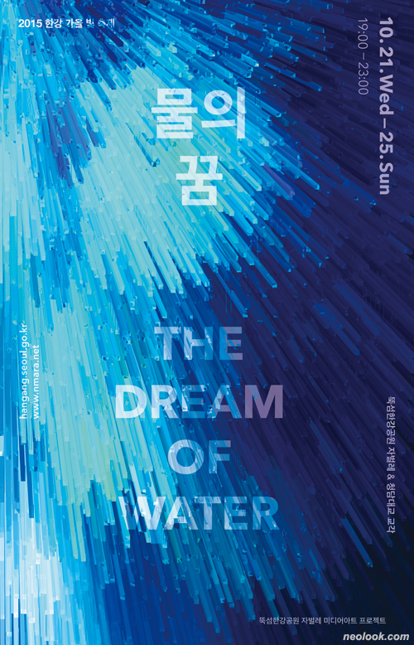
Notes:
Chris Jordan, Glass, Seattle 2004, 44x56”

Slide 7
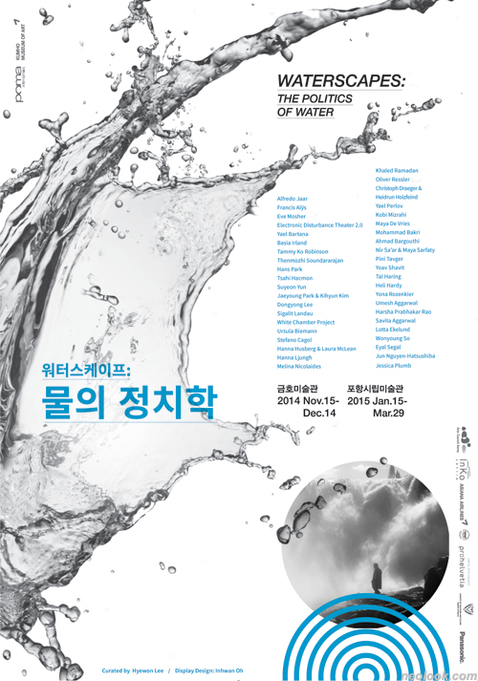
Notes:
Chris Jordan, Glass, Seattle 2004, 44x56”

Slide 8
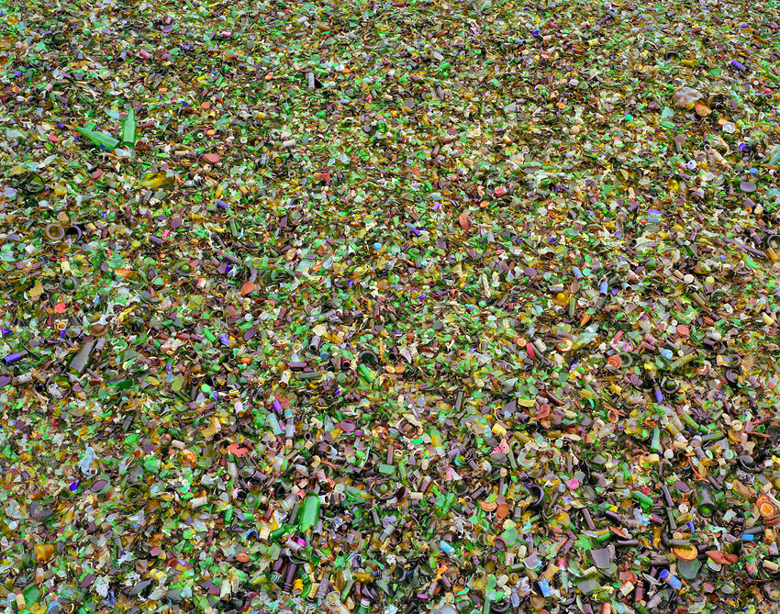
Notes:
Chris Jordan, Glass, Seattle 2004, 44x56”

Slide 9
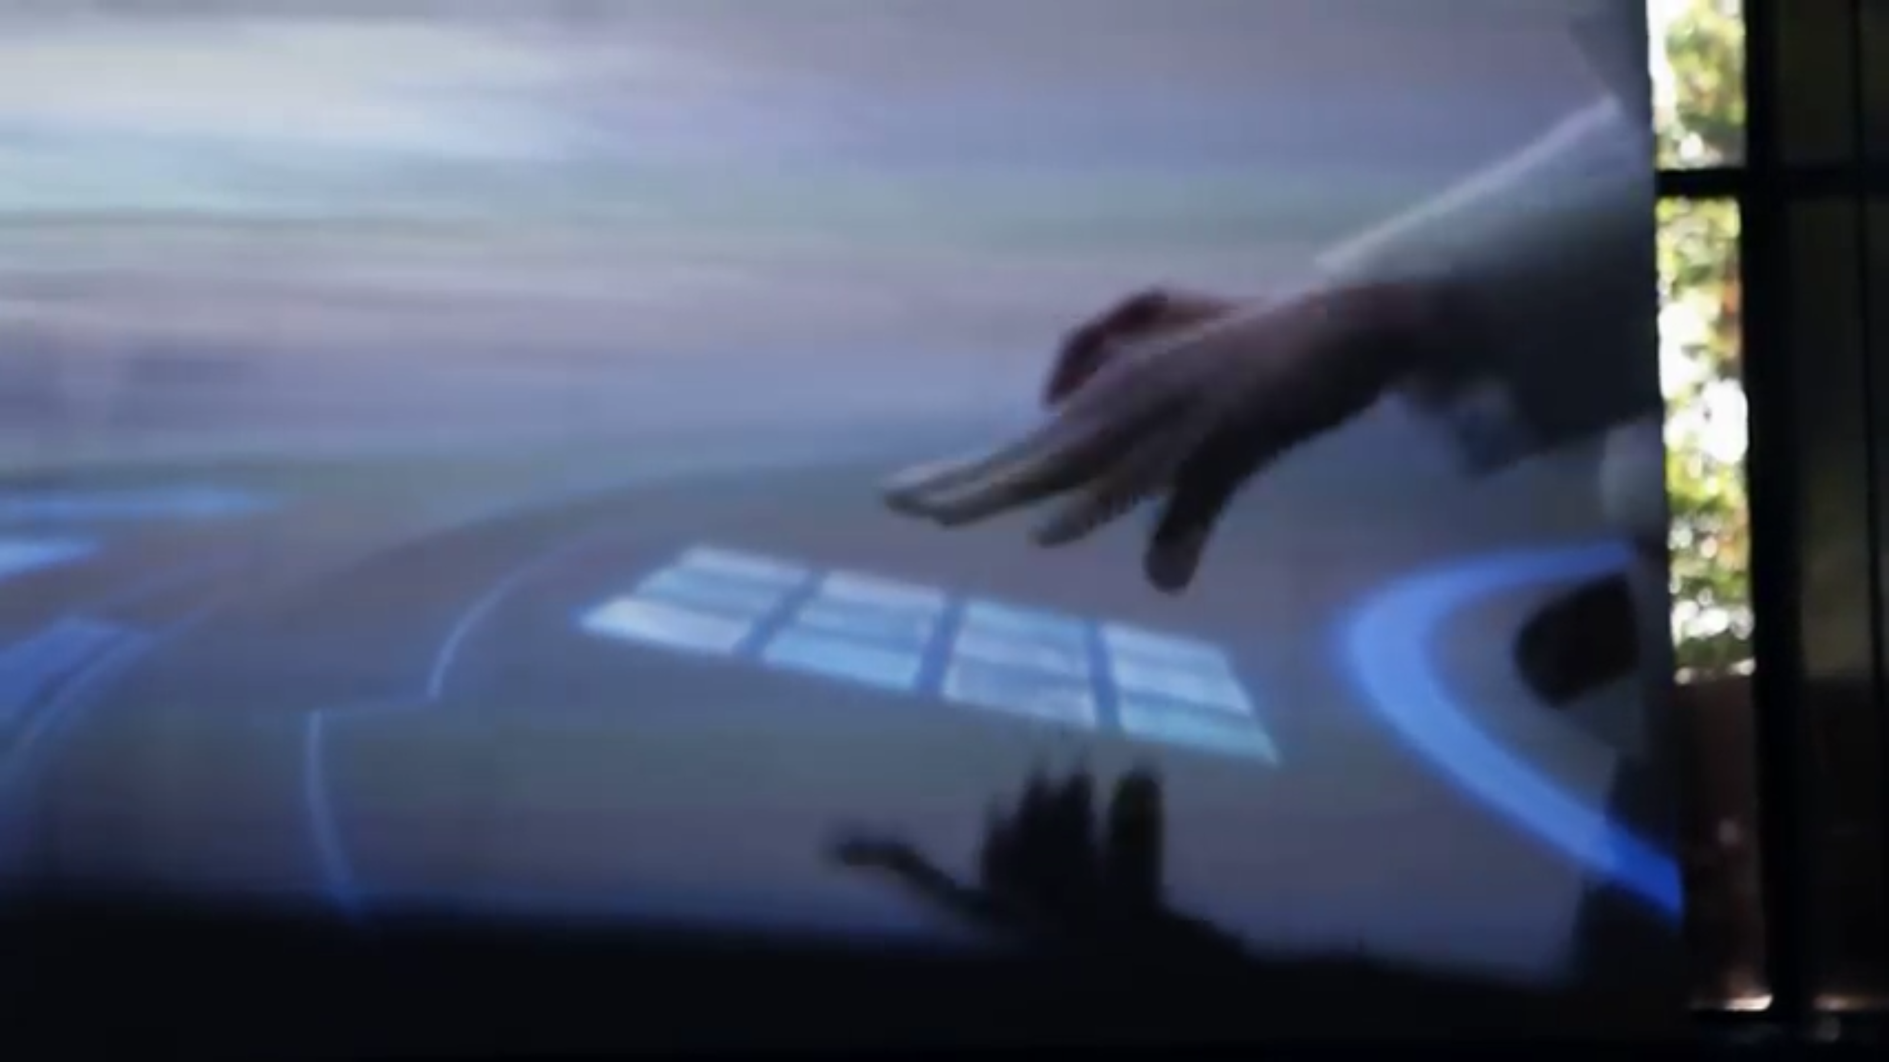
Notes:
Moon Kyungwon & Jeon Joonho, 2015, The Ways of Folding Space & Flying’

Slide 10
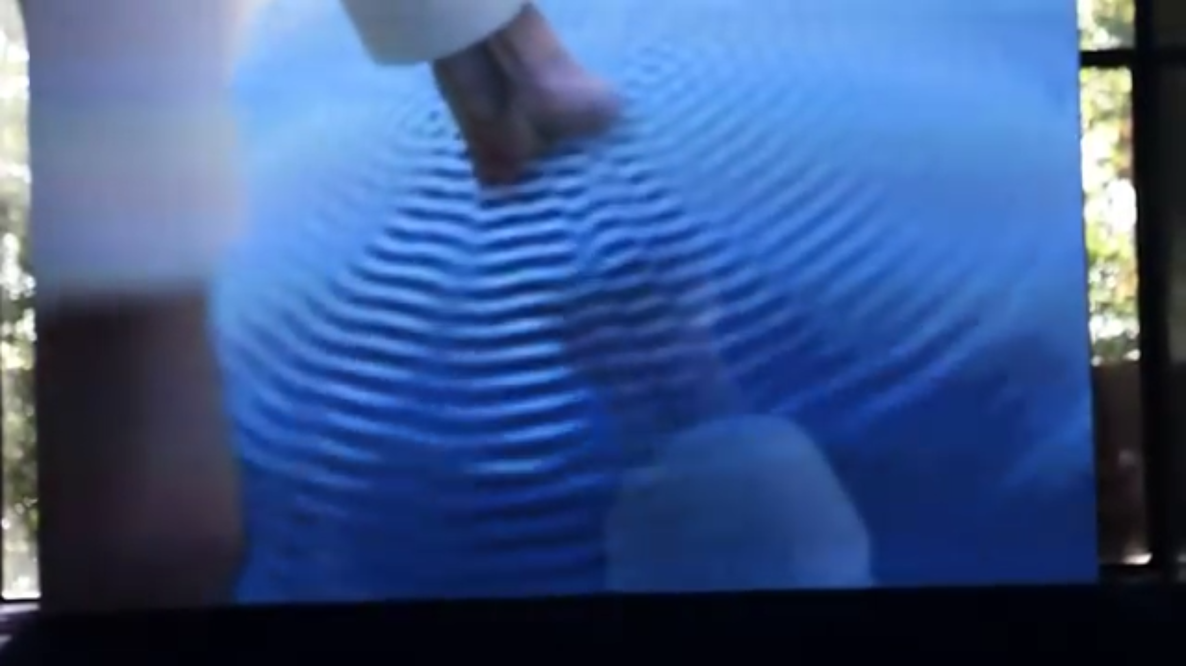

Slide 11
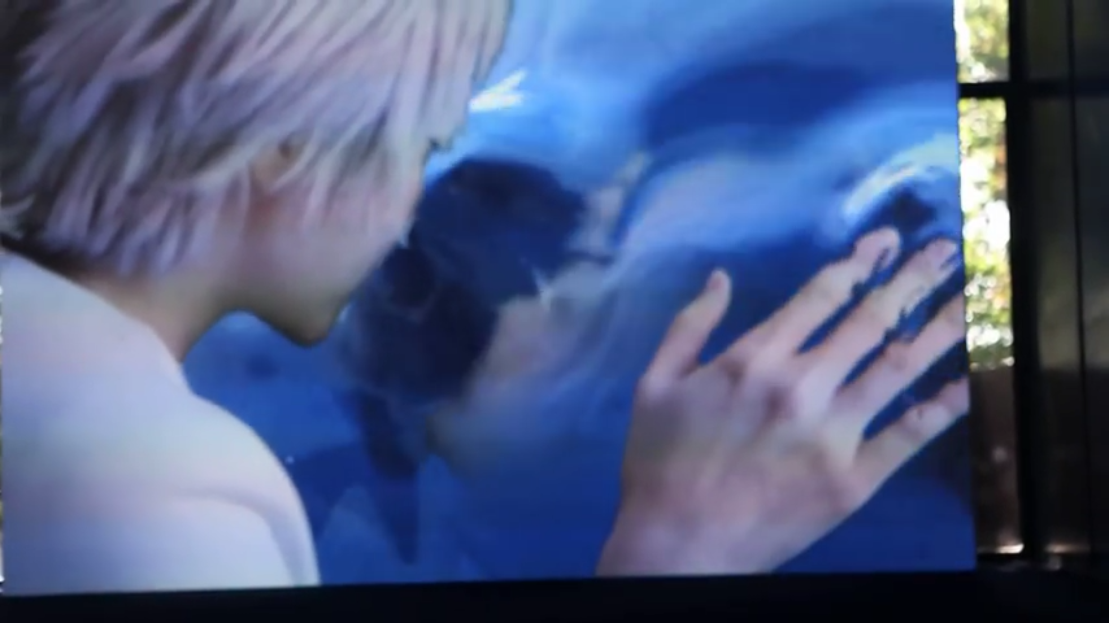

Slide 12
A Trash Talk
One is not born trash but becomes one.
You can step onto the same trash twice.

Slide 13
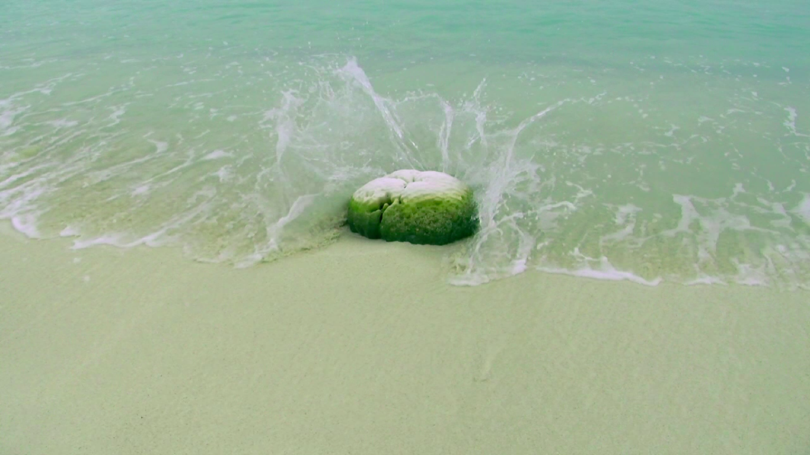

Slide 14
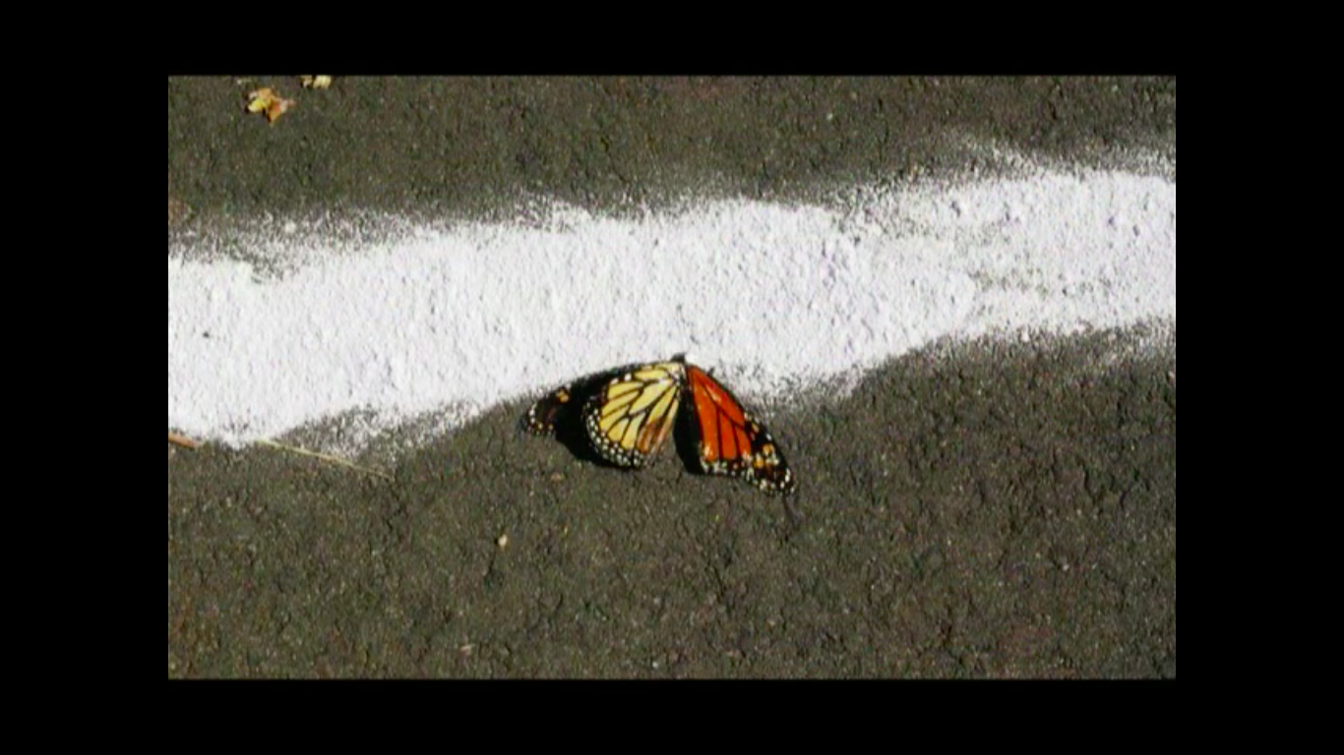

Slide 15
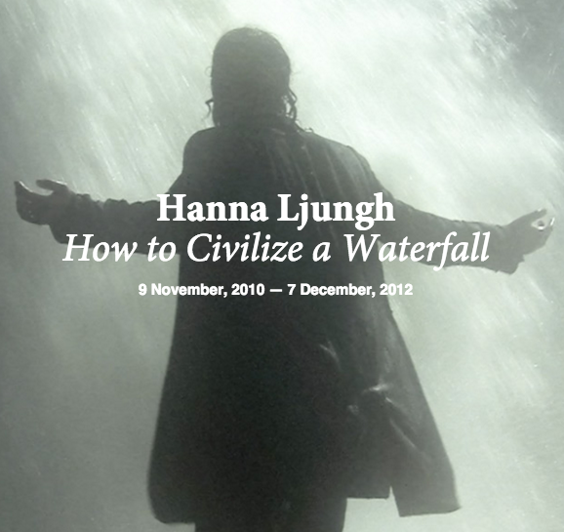

Slide 16
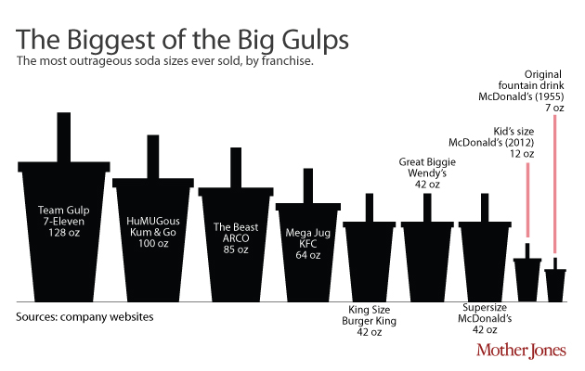

Slide 17
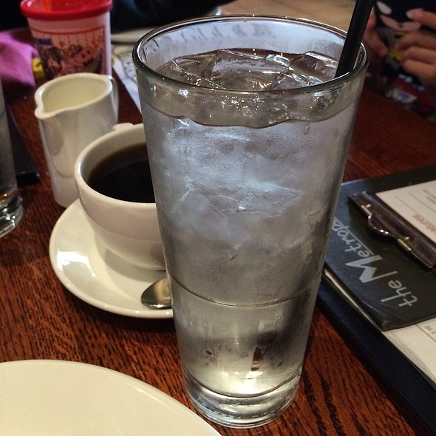

Slide 18
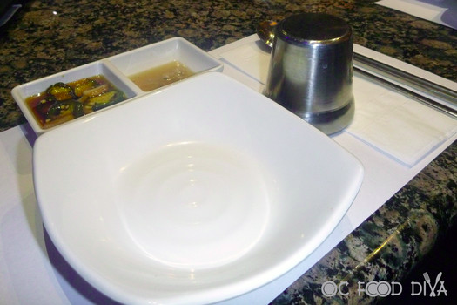

Slide 20
A Trash Talk
One is not born trash but becomes one.
You can step onto the same trash twice.
Treat your trash as you’d trash yourself.

