Slide 1
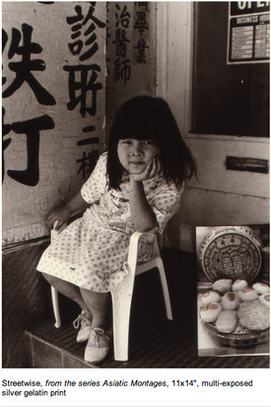
If China Travelled to Descartes:
Cartesianism in Transit—with a Franco-Sino Twist
Kyoo lee
(The City University
of New York)
>Nina Kuo, Streetwise, 1999<

Slide 2


Slide 3
I was increasingly led to question a traditional image of Descartes as the father of the idea of subjectivity qua ‘consciousness’ …
and to fully picture Locke as a theorist of ‘self-consciousness’, whose ideas and problems irrigate every philosophy of the ‘inner sense’ and the ‘reflective self’ from Kant to modern phenomenology.
Étienne Balibar, 1998 (tr. 2013),
Identity And Difference: John Locke And The Invention Of Consciousness

Slide 4
I took into account also the very different character which a person brought up from infancy in France or Germany exhibits, from that which, with the same mind, this individual would have possessed, had he lived always among the Chinese or with savages (des Chinois ou des cannibales).
(Descartes, Discourse on Method, Part II)

Slide 5
Wait, What, Chinese?

Slide 6
Wait, What, Chinese?
I took into account also the very different character which a person brought up from infancy in France or Germany exhibits, from that which, with the same mind, this individual would have possessed, had he lived always among the Chinese or with savages (des Chinois ou des cannibales).
(Descartes, Discourse on Method, Part II)

Slide 7

<Rembrandt, Philosopher in Meditation, 1632>

Slide 8
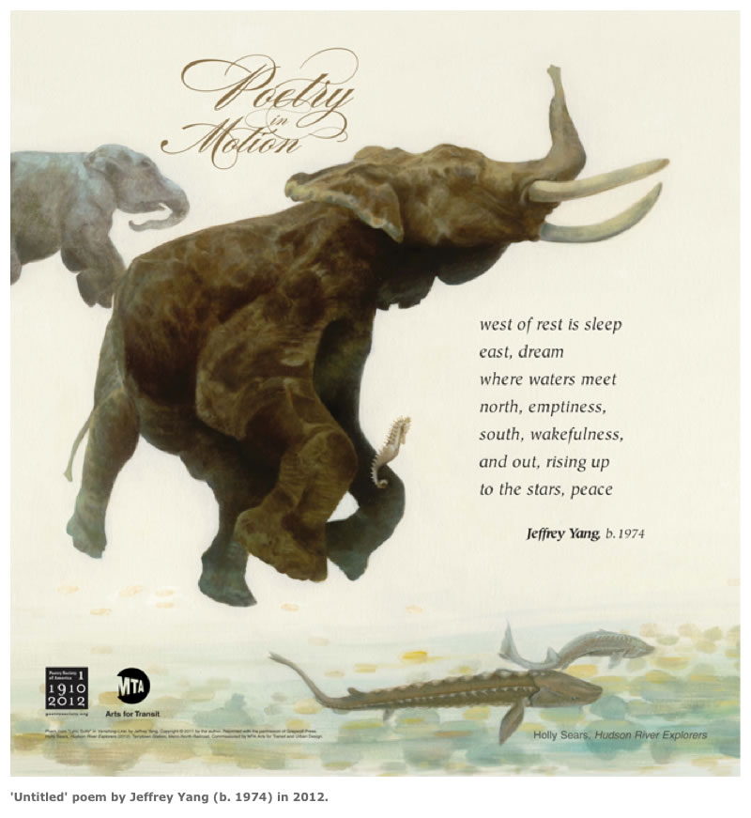

Slide 9
Descartes and “China”
Three Chinas in the Discourse on Method (1637):
“Chinese or Savages”
“Some of the Chinese and Persians”
“Kingdoms of China or Mexico”

Slide 10
1/3
I took into account also the very different character which a person brought up from infancy in France or Germany exhibits, from that which, with the same mind (avec son même esprit), this individual would have possessed, had he lived always among the Chinese or with savages (des Chinois ou des cannibales).
(Discourse, Part II)

Slide 11
“At Odds”
Frank Perkins on Descartes’ Passage on
“Chinese or Cannibals/SAVAGES”:
cultural relativism/universalism
at odds with each other (Leibniz and China):
“He writes in a passage that echoes Montaigne: Descartes comes oddly close to cultural relativism in such passages . His point is that the diversity of human culture and custom proves that culture and custom cannot be relied upon in the search for truth.” (p.34)

Slide 12
2/3
… although there are some perhaps among the Persians and Chinese (les Perses ou les Chinoisque ) as judicious (bien sensés) as among ourselves …
(Discourse, Part III)

Slide 13
3/3
It is plain, that if we consider all external goods as equally beyond our power, we shall no more regret the absence of such goods as seem due to our birth, when deprived of them without any fault of ours, than our not possessing the kingdoms of China or Mexico, and thus making, so to speak, a virtue of necessity, we shall no more desire health in disease, or freedom in imprisonment, than we now do bodies incorruptible as diamonds, or the wings of birds to fly with.
(Discourse, Part III)

Slide 14
Three Chinas/Chinese in the Discourse on Method (1637):
1. Chinese or Savages/Cannibals
I took into account also the very different character which a person brought up from infancy in France or Germany exhibits, from that which, with the same mind, this individual would have possessed, had he lived always among the Chinese or with savages (des Chinois ou des cannibales) …. (Part II)
2. Some of the Chinese and Persians
… although there are some perhaps among the Persians and Chinese (les Perses ou les Chinoisque ) as judicious (bien sensés) as among ourselves … (Part III)
3. Kingdoms of China or Mexico
… we shall no more regret the absence of such goods as seem due to our birth, when deprived of them without any fault of ours, than our not possessing the kingdoms of China or Mexico (que nous avons de ne posséder pas les royaumes de la Chine ou de Mexique) … (Part III)

