Slide 1
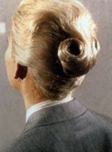
Xuanpin
(The Dark Female Animal) in Daodejing
Kyoo Lee
(City University of New York)

Slide 2
FLOW
老子道德經
Lao
Zi
Dao
De
Jing
玄牝 (六章)
Xuan
Pin

Slide 3
道

Slide 4
德

Slide 5


Slide 6


Slide 7
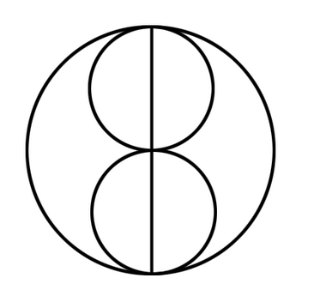

Slide 8
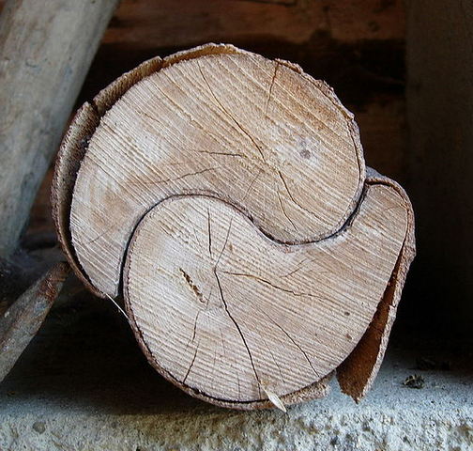

Slide 9
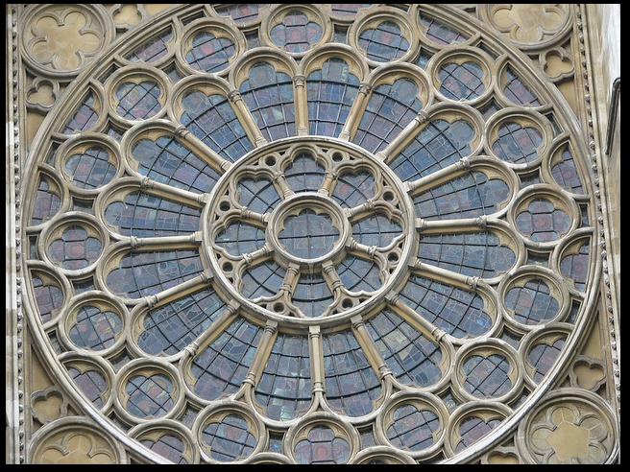

Slide 11
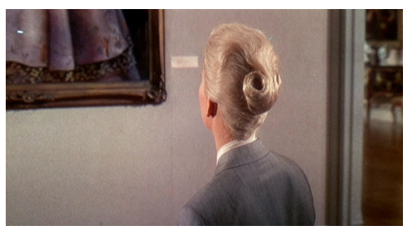

Slide 12
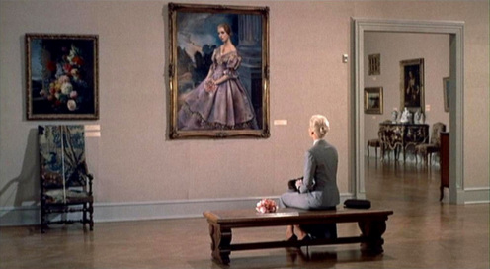

Slide 15
Xuanpin
谷神不死 The spirit of the valley does not pass away.
是謂玄牝 Called the dark womb,
玄牝之門 the gate of the dark womb,
是謂天地根 called the root of Heaven and Earth,
綿綿若存 continuously flowing, seemingly always there,
用之不勤 it is used but not to be used up.
道德經 6章 Chapter 6, Daodejing (my trans.)

Slide 16
玄

Slide 17
牝

Slide 19
"Zen Shaolin" staged in Henan Province, China.
"The extravaganza "Zen Shaolin," with a cast of 500, is staged after nightfall in a valley that sits before a huge mountain in central Henan Province, one of the cradles of Chinese civilization.”
http://www.nytimes.com/slideshow/2008/08/30/arts/dance/20080830_TAN_SLIDESHOW_index.html

Slide 21
SUM
Natality/Vitality/Animality
  The “Sex/Gender” of Dao
Specificity: Material/Sexuated
  Contra Hetersexist/Patriarchal Genealogization
  Metaphysical/Romantic Generalization
Primacy: Onto-Phenomenological
(Obscenity): Hermeneutical/Translational
Further (T)Issues
Co-origination & Origination
Metaphysics & Metaphors
Syncretism & Mysticism

Slide 22
